Slide 1
Miracle Institute of Leadership and Excellence
Pattern Matching and Searching
By,
Srikar Reddy Gondesi,
Junior SQL Server DBA,
Database Team,
Miracle Software Systems. Inc,
Email: sgondesi@miraclesoft.com

Slide 2
Cut
Used for text processing
Used to extract portion of text from a file by selecting columns.
Examples :
cut -c2 ---> Prints 2nd column of each line in a file
cut -c1-3 ---> Prints 1,2,3 columns of each line in a file
cut -c2- ---> Prints 2 character to end of the line

Slide 3
GREP
Where does the name come from?
  GREP – Global Regular Expression Print
How it works?
  grep looks inside file(s) and returns any line that contains the string or expression
  prints lines matching a pattern to STDOUT

Slide 4
GREP
grep Pattern
  grep Pattern filename
  Ex. grep ‘permission’ thisFile
  grep pattern file1 file2
  Ex. grep ‘permission’ file1 file2
  file1:
  file2:
If grep cannot find a line in any of the specified files that contain the requested pattern, no output is produced.

Slide 5
SED
Look for patterns one line at a time, like grep
Change lines of the file
Non-interactive text editor
  Editing commands come in as script
  There is an interactive editor ed which accepts the same commands
A Unix filter
Superset of previously mentioned tools

Slide 6
SED Syntax
Syntax: sed [-n] [-e] [‘command’] [file…]
sed [-n] [-f scriptfile] [file…]
-n - only print lines specified with the print command (or the ‘p’ flag of the substitute (‘s’) command)
-f scriptfile - next argument is a filename containing editing commands
-e command - the next argument is an editing command rather than a filename, useful if multiple commands are specified

Slide 7
SED Examples
sed ‘1d’ file.txt
sed ‘1,6d’ file.txt
sed ‘2,5!d’ file.txt
sed ‘2,5p’ file.txt
sed ‘s/unix/linux/’ file.txt
sed ‘s/unix/linux/g’ file.txt
sed ‘s/unix/linux/5’ file.txt
sed ‘s/unix/linux/w file_name’ file.txt
sed ‘s/unix/linux/i’ file.txt
sed ‘10s/unix/linux/g’ file.txt

Slide 8


Slide 9
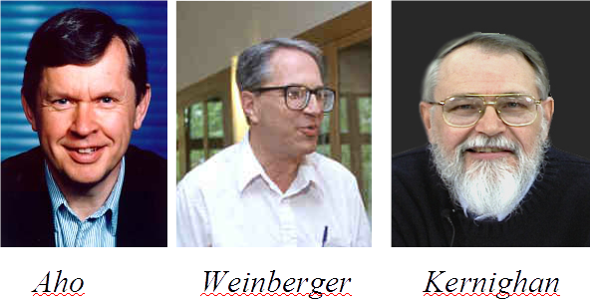
Why is it called AWK?

Slide 10
AWK Introduction
awk's purpose: A general purpose programmable filter that handles text (strings) as easily as numbers
  This makes awk one of the most powerful of the Unix utilities
awk processes fields while sed only processes lines
nawk (new awk) is the new standard for awk
  Designed to facilitate large awk programs
  gawk is a free nawk clone from GNU
awk gets its input from
  files
  redirection and pipes
  directly from standard input

Slide 11

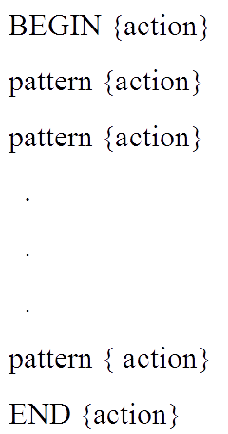
Structure of an AWK Program
An awk program consists of:
  An optional BEGIN segment
    For processing to execute prior to reading input
  pattern - action pairs
    Processing for input data
    For each pattern matched, the corresponding action is taken
  An optional END segment
    Processing after end of input data

Slide 12
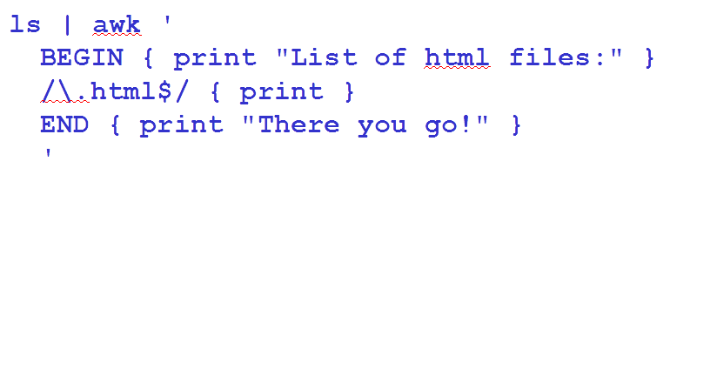
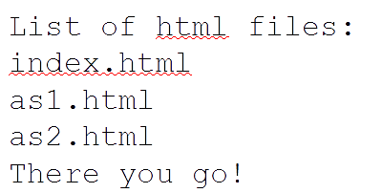
An Example

Slide 13
Running an AWK Program
There are several ways to run an Awk program
  awk 'program' input_file(s)
    program and input files are provided as command-line arguments
  awk 'program'
    program is a command-line argument; input is taken from standard input (yes, awk is a filter!)
  awk -f program_file input_files
    program is read from a file

Slide 14
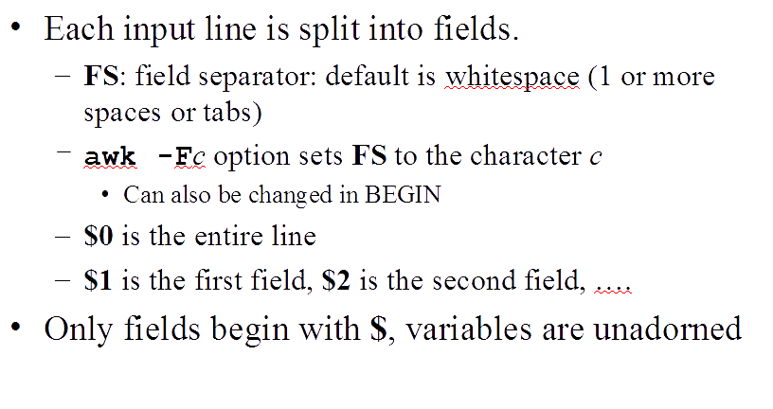
Fields

Slide 15
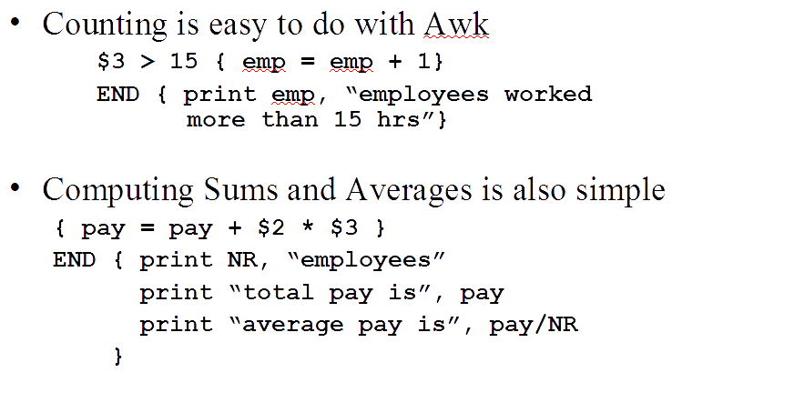
Computing with AWK

Slide 16
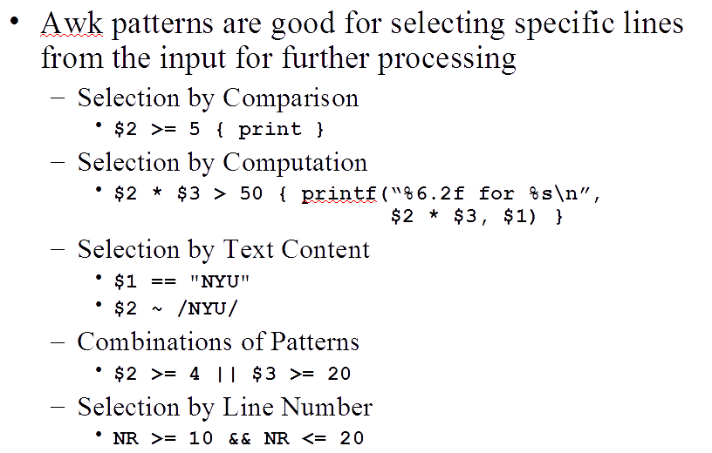
Selection with AWK

Slide 17
THANK YOU

